Slide 1
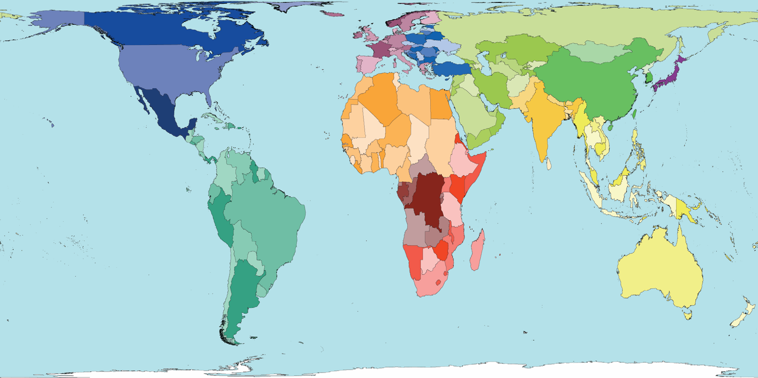
TRAINING IN TRAUMA & EMERGENCY SURGERY: THE SOUTH AFRICAN MODEL d Allard – South Africa
Education – ESTES 2010
Notes:
It is a great honour to address you here in the name of the South African trauma society and I thank the organizing committee for giving us the opportunity to share with you our experience with this unnamed worldwide epidemic....
I wasn’t born far from here and trained in one of the universities of this city...... And I am a good example of the phenomenon of ‘medical migration’ on this planet…
When too many surgeons-in-training are competing for exposure and hands-on experience, a perverse counter-effect happens and the quality of the training and of the trainee is at risk...
Today I am one of 20 South African recognized trauma surgeons and I am heading a secondary level hospital in the most violent ganglands of Cape Town….We provide both trauma and emergency care…..Besides repairing stab wounds to the heart or doing a damage control shunting of big arteries….I do the odd colectomy for obstructing cancer, deal with perforated ulcers and teach the techniques for amputations
We are analysing together in 15 minutes the model of trauma and emergency surgery that South Africa has developed…

Slide 2
Notes:
We are all interconnected in this global village and trauma care knows the same challenges all over the planet...
Donald Trunkey from the US and Ari Lepaniemi from Finland are part of those leaders who share their views internationally....and this IATSIC symposium published in 2008 gives you a superb view of the current situation in the world...and I invite you to read it...

Slide 3
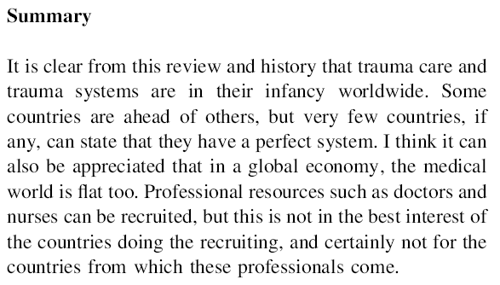
Notes:
Donald Trunkey summarizes by saying that... ‘It is clear that trauma care and trauma systems are in their infancy worldwide....’ and that recruitment of professional resources is not in the interest of any country.....
He says further that..... ‘South Africa has a trauma system; however, it borders on being overwhelmed’.....

Slide 4
Notes:
When I left my comfort zone to do my last year of training as a general surgeon for the Belgian system at the University of Cape Town (12 years ago)….I was amazed by how experienced my colleagues from Groote Schuur Hospital were….
Most had trained in the ‘Advanced Trauma Life Support course’….most were familiar with the principles of ‘Damage control surgery’ in trauma… most had solid operating skills…and took their academic preparation for the fellowship examination very serious.
In SA...the medical schools (universities) teach (the basic medical degrees), the colleges of medicine examine (for the specialisations and diplomas) and the HPCSA does the registration of all health disciplines...
In SA…first world medical system meets a third world pathology….! And here comes the fundamental value of such a system…

Slide 5
Notes:
The young woman who is suturing a bleeding heart on this picture joined my department 10 years ago when she was fresh out of her community service....she is one of those candidates who always knew that she wanted to become a surgeon...dedicated and hard-working...friendly and compassionate towards her patients...assertive and decisive during her operating procedures...
In the 3 first years after her medical training, she assisted or operated
-150 lumps & bumps - 130 sterilizations – 100 tonsillectomies – 100 laparotomies (50 for trauma)- 80 gastroscopies- 70 amputations and hernias, haemorrhoidectomies…
In the next three years BEFORE joining the Cape Town training program, she did 200 trauma laps- 100 acute abdomen laps – 250 hernia repairs- 50 thoracotomies and 10 vascular repairs….
…on her first weekend call in my department she performed 9 laparotomies for penetrating trauma...it was still two years before she was to go on the registrar rotation!
Today she is the first surgeon to sub-specialize in trauma surgery in the Cape Town program.
Three years ago a visiting Swiss surgeon experienced in 6 month as a visiting surgeon as many procedures in trauma then he would have done in Switzerland in a 65 year career!

Slide 6
Notes:
South Africa is the first country worldwide to have a registered ‘sub-specialty certificate in Trauma Surgery’ (Cert trauma Surgery (SA)) since August 2007....and for the first two years the general surgeons working in the field who had gained some recognition amongst their peers...could apply for registration under the ‘grand-father clause’.
By August 2009 the Health Professions Council of South Africa had registered 20 trauma surgeons. These are the ones who dedicate their careers to save and heal....teach and train...manage and lead the cause of trauma surgery in the country.
All this wouldn’t be if it wasn’t for the passion and vision of a few....Professor Lynne Baker, an orthopaedic surgeon from Durban who recognized the value of ATLS and brought the course over to South Africa....Professor Ken Boffard, past national president of ATLS & the SA trauma society, current president of the ISS...who is one of the main driving forces in the SA trauma world...and Professor Jacques Goosen, who published this paper back in 2008….describing the SA trauma & emergency surgery model
My talk today is based on their accurate description and I thank them for their mentorship...

Slide 7
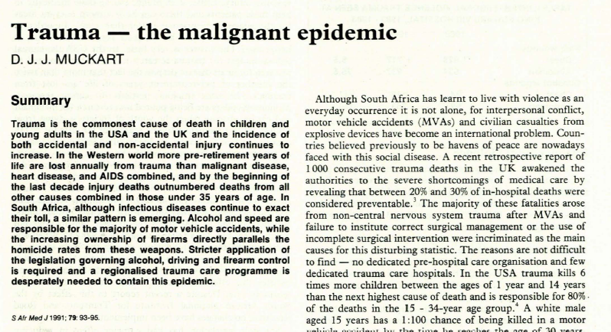
Notes:
…..‘South Africa is a low- to middle- income country that avoided a civil war but replaced a political struggle with criminal violence’….
The country has a population of 48 million people, a life expectancy at birth 20 years shorter then in the developed world and a burden of disease championed by HIV/Aids and traumatic injuries both intentional and non-intentional…
A few month after the release of Nelson Mandela in 1990, Professor David Muckart from Durban spoke already about the ‘malignant epidemic of trauma’…and wished for firearm control and regionalized trauma systems…
20 years later we have a more organized ambulance service in the urban areas….and yet the optimum response time gets achieved only 18% of the time……
Our firearm possessions are regulated….and yet the number of illegal firearms is still out of control….
Alcohol sales are regulated…and yet the large majority of trauma victims are intoxicated

Slide 8
2794
Notes:
…one in every 15 death (6.7%) is caused by Homicide and violence and one in every 27deaths by Road accidents (3.3%)…
We have the second highest violent crime rate in the world after Columbia……
In Cape Town alone, in the last three years 2794 people got murdered by penetrating injuries…..in a country not at war!….by comparison that many people got killed in the Israeli Palestinian conflict over 5 years….
55% were killed by a bullet…..58% had a wound to their heart….

Slide 9
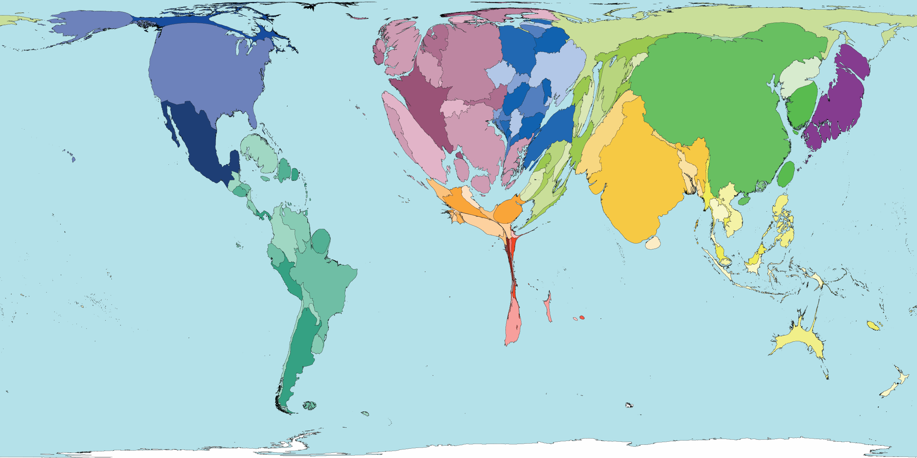
physicians
Notes:
This is the world map according to the repartition of the 9.6 million physicians….
SA is hobbled by an important shortage of all categories specialists in the public service….and the disparities of income are forcing those working in public to do extra private work…80% of the population benefit from a ‘free access’ public healthcare service that employs roughly 20% of the registered medical practitioners….
The ‘first world’ SA private sector… looks after 20% of the insured population and employs 80% of the doctors!
Our quotas for historically disadvantaged groups and race are advantaging our black students and yet only few are choosing the financially demanding specialization route…
Thanks to female role-models like Wanda, we are attracting more and more of the largest female medical student population into the surgical careers... Two thirds of my medical officers preparing for a training post in surgery are currently women!....the new challenge will be to marry family needs with trauma surgery.

Slide 10
Notes:
Trauma surgery in SA today is a combination of selective conservatism, minimally invasive procedures and endo-luminal techniques, critical care and referral to other specialties like orthopaedics and neurosurgery (that remained in charge of ortho and neuro-trauma). Most operating will happen after hours. A lot of operating is done on penetrating truncal trauma.
In order to be eligible to take the examination as a trauma sub-specialist, the candidate must hold a specialist degree and must have trained over a minimum of two years in a level 1 trauma unit....under the supervision of a registered trauma surgeon....and must provide a logbook....as well as a having completed with satisfaction the required level of technical and operative skills...
We examined our first SA trauma sub-specialist a few days ago....on all pertinent aspects of applied anatomy, trauma physiology, haemodynamics, trauma pathology, ultrasonography and non-invasive trauma diagnosis, angiography and trauma radiology....
We see trauma as a (general) surgical disease which requires general (trauma) surgeons to lead the trauma team. With some formal training in the other trauma disciplines (neuro and ortho)...
And when all that is done....

Slide 11
Notes:
The challenges remain many...
We do not have the resources to provide multiple sub-specialties on call....we need to keep the surgeons general...at this time we can not consider further division into specialized emergency surgeons...
We might need to combine emergency surgery and trauma to maintain our operative skills levels....
We accept that the specialty involves after-hours work and that obtaining and maintaining skills requires a lifelong commitment...
We need a cadre of academic and private sub-specialists to provide leadership, training and skills verification so desperately needed
The push and pull factors will always keep rearranging the countries resources...we hope that trauma surgery will be a pull factor that will retain or attract passionate and dedicated surgeons to South Africa.
I thank you for your attention.

Slide 12
denisallard@mweb.co.za ...see you in Cape Town

