Slide 1
Denis Allard Health Economics Brussels - ESTES 2010
Trauma in South Africa - ‘How to do a lot with a little’
Notes:
I am Denis Allard from Luxemburg, working as a trauma surgeon in the townships of Cape Town…
I am going to try to give you in 15 minutes a view of the challenges that trauma care faces in South Africa where 30000 health care professionals are trying to facilitate the healing of a nation with more than 48 million people…
…and we’re trying to examine what can be relevant to your own practice as Trauma & Emergency care practitioners here in Europe…

Slide 2
Notes:
South Africa is the 27th biggest economy in the world and it accounts for almost 25% of the GDP of the entire African continent….
….it has the youngest Constitution in the world and more than 50000 people are moving every single month from the townships into the suburbs of the country…
…the beautiful peninsula around Cape Town has the fifth-best blue sky in the world and we are going to be the second nation ever to have hosted the rugby, cricket and soccer world cup….
…..South Africans really have a lot to be grateful for….And yet the challenges are many and they are real…..
A Black South African today will have a life expectancy 20 years shorter then in the developed world…..the socio-economic gap remains large and fuels a high crime rate….

Slide 3
2794
Notes:
The ten leading causes of premature mortality are championed by HIV/Aids (39%)….followed in second place by trauma….
…one in every 15 death (6.7%) is caused by Homicide and violence and one in every 27deaths by Road accidents (3.3%)…
We have the second highest violent crime rate in the world after Columbia……Cape Town is the city with the highest violent death rate…..and my hospital serves the people from the highest crime rate areas…..
In Cape Town alone, in the last three years 2794 people got murdered by penetrating injuries…..in a country not at war!….by comparison that many people got killed in the Israeli Palestinian conflict over 5 years….
55% were killed by a bullet…..58% had a wound to their heart….

Slide 4
Notes:
When one analyzes the reasons for the violence….the past collective pain must not be underestimated….it is in the conditioned make-up of many young South Africans today…..
With these figures in mind, ‘how can one remain enthusiastic about life in general and trauma in particular’?

Slide 5
Set point Conditions of living Voluntary Activities
Notes:
The latest research on ‘happiness’ has shown that 40% of it is determined by our genetic & familial conditioning….and that is a set point that you will have to modify with therapy, antidepressants or meditation….
10% only is influenced by our circumstances or conditions of living…..and winning in the lottery or become paraplegic is not going to change that in the long-term….because we are highly adaptable human animals….
50% of your state of happiness is determined by conscious decision-making or voluntary actions…like physical exercise…nurturing relationships and finding deeper purpose…..caring for the trauma victims can be that deeper purpose
My first ‘take-home message’ would be….’be passionate and positive about what you can achieve in your profession’. You will be a happier person for it!

Slide 6
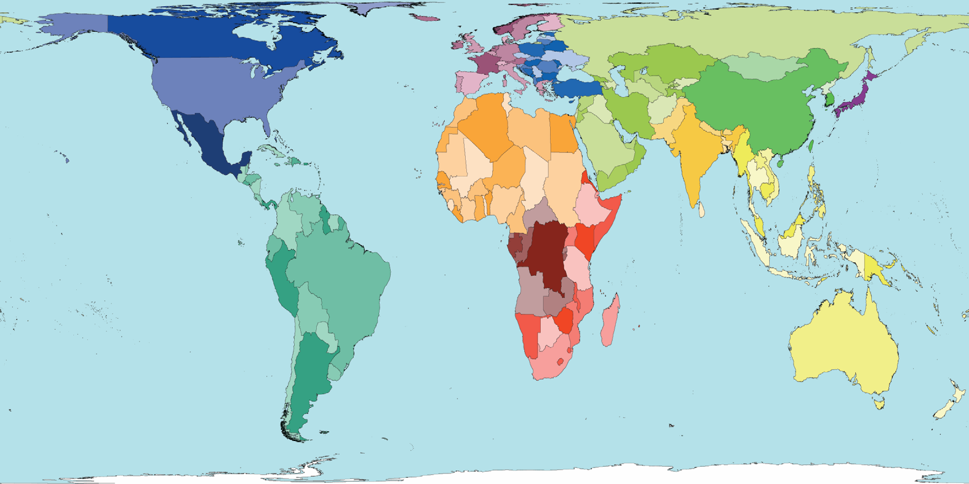
world map
Notes:
World map
We all love our earth so much……we better take good care of it………it’s the only one we got for the moment!

Slide 7
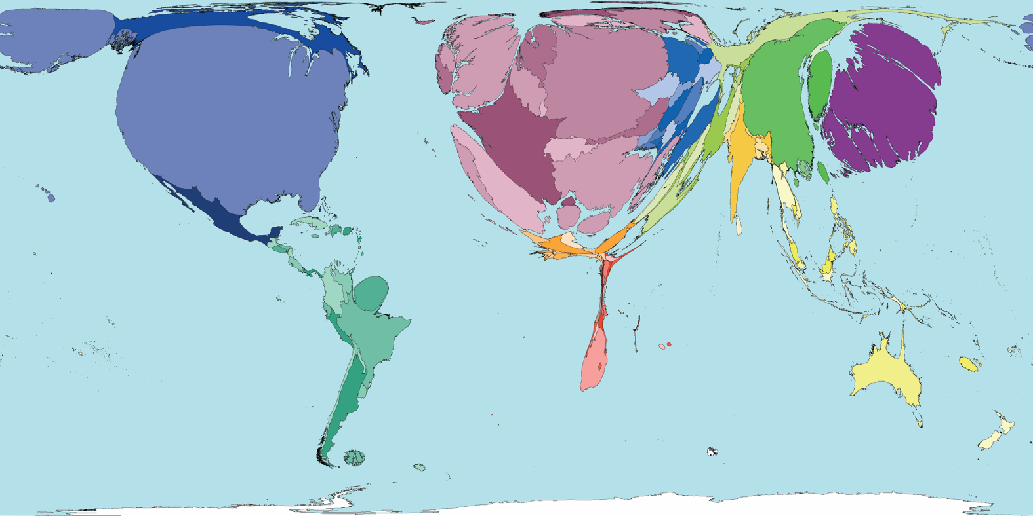
public health spending
Notes:
This is the map of the world according to public health spending in each country…
SA has the highest ‘health spending per capita’ on the African continent – 106 USD – 21 times less then the highest spending nation of the developed world, the USA…
‘A disaster is when the supply of medical resources is outstripped by the demand on the health care system’…..and that is happening most of the time in most of the African continent

Slide 8
South African Med J. 2005 Aug;95(8):591-4. The cost of treating serious abdominal firearm-related injuries in South Africa Allard D, Burch VC. Department of Surgery, G F Jooste Hospital, Cape Town. denisallard@mweb.co.za Abstract INTRODUCTION: Firearms, the leading external cause of non-natural deaths in South Africa, claim approximately 15,000 lives annually. Up to 127,000 firearm-injured victims seek state health care assistance per annum. The fiscal burden of treating these injuries is not known. METHODS: All serious abdominal firearm-related injuries (requiring admission to hospital and emergency surgery) presenting to a state hospital over a 6-month period were reviewed. A cost analysis using five variables was performed: operating theatre time, duration of hospital and high-care unit stay, pharmaceutical and blood products used, laboratory services used and diagnostic imaging studies performed. RESULTS: Twenty-three patients with serious abdominal gunshot injuries were admitted, of whom 21 (91%) were treated at the hospital from admission until discharge. Each admission cost approximately US dollars 1,467. Hospital stay (47%) and operating theatre (30%) costs accounted for most of the total cost. Pharmaceuticals and blood products (20%), laboratory services (2%) and imaging studies (1%) contributed less than 25% to the total cost. CONCLUSION: Serious abdominal gunshot injuries cost at least 13-fold more than the annual per capita South African government expenditure on health. This fiscal burden of approximately US dollars 2.9 million, almost 4% of the annual health budget, does not include the cost of treating other serious gunshot injuries. These findings highlight the need for successful violence prevention strategies in South African.
Serious abdominal gunshot injuries cost at least 13-fold more than the annual per capita South African government expenditure on health.
Notes:
And this disaster is compounded all the time by man created trauma.....
We showed 5 years ago that life had maybe no price...but that it had a definite cost!

Slide 9
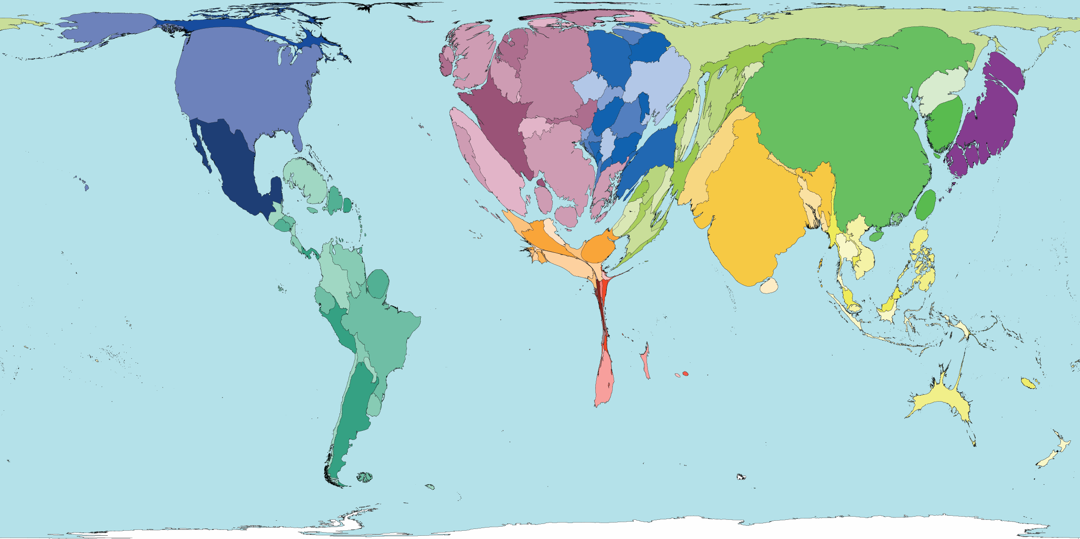
physicians
Notes:
This is where the 9.6 million Physicians are working on the planet
In SA there are less than 2 surgical specialists per 100,000 populations….that is why many rural family physicians are still doing basic surgical procedures today….

Slide 10
Notes:
in my department with 80 beds, 2 senior surgeons heading a team of 8 doctors in training and 6 interns:
…450 patients get hospitalized every month of which 250 will get a surgical procedure….25 needing a laparotomy or a thoracotomy for trauma…
A medical officer before getting into a specialization post will have done in my department over 100 trauma laparotomies and over a dozen thoracotomies on top of the 100 amputations and sepsis surgery…

Slide 11
Teaching
Notes:
To deliver basic trauma care, one does not need to be a trauma surgeon….by training courses and medical education one will spread the common language of trauma care!
Bedside teaching, operating room teaching and basic surgical skills courses are all part of a teaching culture in South Africa
Over 10,000 doctors were instructed in the 683 ATLS courses that were held in SA since 1992….and they are rendering the initial care of the trauma patient as good as possible…
450 surgeons-in-training were taught in the 25 Definitive Surgical Trauma Care courses held since 2000.
Trauma surgery is the youngest official sub-specialty and we were examining our first trauma surgeon by a college exam earlier last week.
So the second ‘take-home message’ would be ‘train and teach the manpower of the future’….

Slide 12
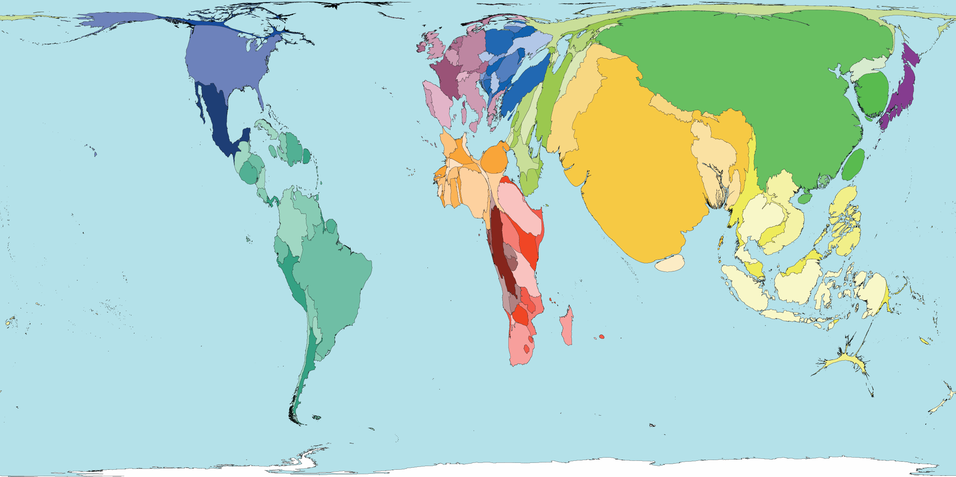
road accident death
Notes:
Road traffic accidents worldwide in 2001 caused just under a million (984.000 thousand) deaths.

Slide 13
Notes:
The distances in Africa are great and to place the emergency services strategically remains a challenge....
In Cape Town, 3.12 million people are calling 1000 times the emergency number over a weekend day!....the pre-hospital system has 70 vehicles and 1 helicopter to respond to those emergency calls....
The response time is under the acceptable 15 minutes limit.....only 18% of the time on average

Slide 14
Major trauma centre
Regional Trauma centre
Notes:
SA has over 300 hospitals and clinics, 20 trauma surgeons and many surgeons who deal with trauma on a regular basis….in the regional and district hospitals of the country….
We know today that community trauma centres, who can do the initial resuscitation and often in penetrating trauma the definitive care, can take off the load of the major trauma centres and improve time to definitive care and overall outcome and complications…
By applying ‘triage’ principles you will improve patient flow at all levels and these must be reapplied along the whole chain of trauma care....

Slide 15
Notes:
Trauma in SA deals with a lot of potentially severe and often relatively benign conditions like penetrating thoracic trauma...and dealing with 83 patients like that every month made us become very pragmatic and practical...
These three patients have their ‘Heimlich-valve’ portable drain hanging around their shoulder and they are walking in order to re-expand their lungs...
We are removing chest drains after a minimum of twelve hours...on average these patients are staying for two to three days....

Slide 16
236 Penetrating cardiac injuries
Notes:
Over the last ten years 236 patients with a wound to the heart got operated at our trauma centre where there is no blood bank and no angiography or after hour CT scan…..
…and thanks to rapid interventions, the recent use of FAST and more rapid access to theatre overall 70% survived......
Third ‘take-home message’ .....’good outcome depends on rapid access to definitive care’

Slide 17
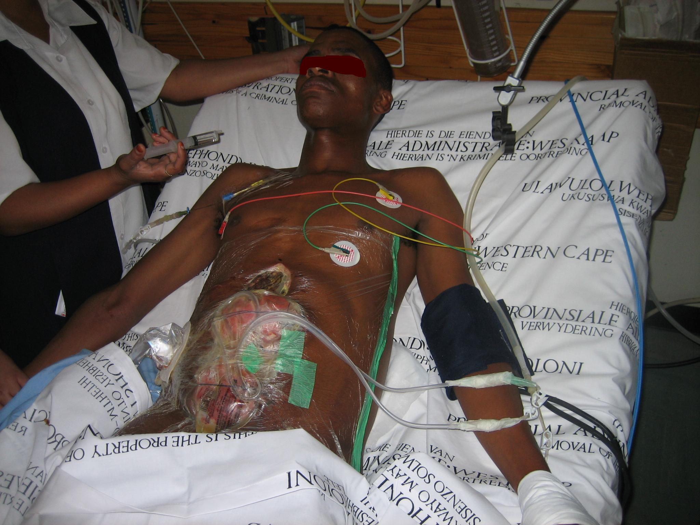
Notes:
Advanced trauma care of today means ‘understanding the physiology’…
…and all the recent advances in Fluid resuscitation – acute traumatic coagulopathy - Damage control surgery - Prevention of sepsis – and critical care
are making good outcomes achievable..
We are achieving 96% survival rates in GSW and Stab laparotomies in a regional trauma center…
Take home message ‘The trauma surgeon of today is not operating on the anatomy but on the physiology of the patient’

Slide 18
Br J Surg. 2003 Jun;90(6):718-22. Temporary closure of open abdominal wounds by the modified sandwich-vacuum pack technique. Navsaria PH, Bunting M, Omoshoro-Jones J, Nicol AJ, Kahn D. Trauma Unit, Groote Schuur Hospital, Cape Town, South Africa
Notes:
‘Clinical audits and research are important tools in surgery’...
My colleagues from the Cape Town University have extensively published their audits and series and have made the surgical world a richer place....
The major trauma units must publish on top of the service delivery...

Slide 19
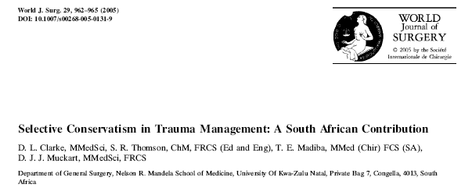
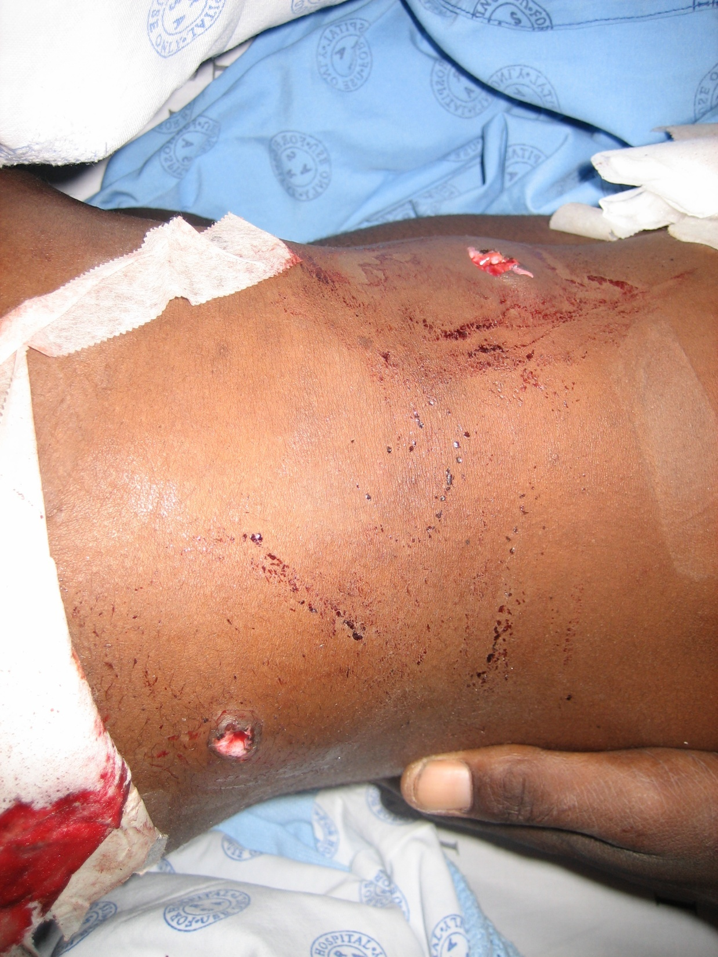
Notes:
This is an excellent paper from our Durban colleagues that overviewed how in the setting of limited resources and an overwhelming volume of trauma, selective conservatism as a surgical philosophy took root and has profoundly influenced the way the world manages trauma.
So take home message: ‘remain conservative whenever possible’

Slide 20
’Be passionate and positive about what you can achieve in your profession’….You will be a happier human for it! * ‘Train and teach the manpower of the future’ * ’Good outcome depends on rapid access to definitive care’ * ‘The trauma surgeon of today is not operating on the anatomy but on the physiology of the patient’ * ’Clinical audits and research are important tools in trauma surgery * ‘Remain conservative whenever possible’
Notes:
In conclusion dear colleagues
1 ’be passionate and positive about what you can achieve in your profession’. You will be a happier human for it!
2 ‘train and teach the manpower of the future’
3 ’Good outcome depends on rapid access to definitive care’
4 ‘The trauma surgeon of today is not operating on the anatomy but on the physiology of the patient’
5 ’clinical audits and research are important tools in trauma surgery
6 ‘remain conservative whenever possible’

Slide 21
denisallard@mweb.co.za ...see you in Cape Town

