Slide 1
MANAGING TORSO TRAUMA WITHOUT CT SCAN
Dr Denis Allard, trauma surgeon, South Africa

Slide 2
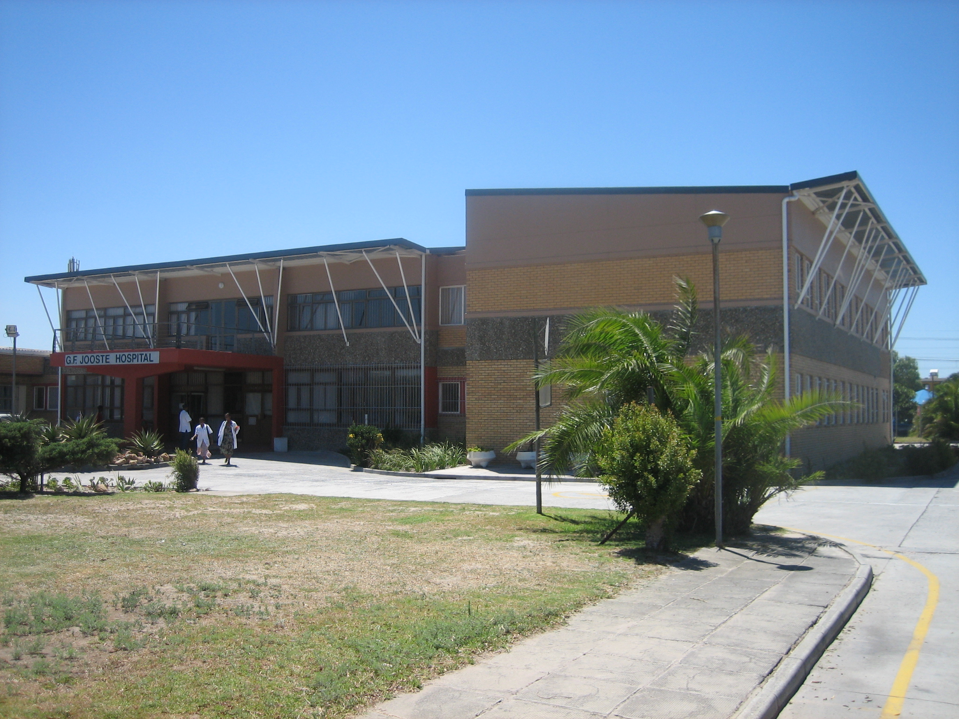

Level 2 Emergency & trauma township hospital
1.3 million capture area
High poverty / crime / HIV rates
250 torso trauma op’s yearly
Junior staff, one trauma surgeon
2 theaters; 350 op / month
Daytime CT since 2005

Slide 4
Survival rate in percentage:
ICD treated thoracic trauma: 99%
Thoracotomy thoracic trauma: 73%
In penetrating cardiac injury: 75%
In Gunshot injury: 35%
Stab laparotomy: 96%
Gunshot laparotomy: 88%
Blunt laparotomy: 86%

Slide 5
Penetrating versus blunt torso trauma
Overall management guidelines are the same
Penetrating torso trauma patients have more often indications for surgery
Penetrating torso trauma patients have less often a diminished sensorium
Presence of intraperitoneal blood in stable patients (blunt and penetrating) is never an absolute surgical indication…..Signs of massive blood loss usually is!
Experienced clinical hands are the best tool to assess any trauma patient.

Slide 6
Acute versus late phase management
Patients with delayed presentations or complications from the initial procedures will almost always require CT scan investigations
in torso trauma patients…

Slide 7
Use of FAST
All blunt torso trauma patients that have a diminished sensorium or signs of hemorrhage
All penetrating wounds to the precordium
Penetrating chest wounds with clinical suspicion of cardiac injury
In the following patients…

Slide 8
Computed Tomography
The average CT scan delivers the radiation of over 150 chest X-rays
CT results should give you (ideally) a major change in management, not merely confirm what you suspected
CT does not stop an active bleeding
Interventional CT angiography does take a lot of time in the best hands and is rarely available after hours

Slide 9
No indication for CT scan
All patients with signs of shock
All stable patients that have a clear indication for surgery
All patients that can be treated with intercostal drain (ICD) based on chest X-ray
All multiple injured trauma patients with a negative abdominal FAST and with low probability of hollow viscus injury
in the following patients….

Slide 10
Optional indication for a CT scan
Stable blunt multiple trauma with a positive FAST
Tangential gunshot wounds without indication to surgery
Stable ventilated blunt multiple trauma patient that has non-explained pyrexia or fails to improve his clinical condition
Stable penetrating torso patients that are candidates for selective non-operative management (SNOM)
In the following patients…

Slide 11
Indication for CT scan
All stable patients with trans-mediastinal gunshot wounds
All stable patients with a widened mediastinum on chest X-ray
All patients with delayed onset of soft vascular injury signs (pulsating mass, bruit)
All patients with non resolving large hemo-thorax after multiple chest drain insertions
In the following patients…

Slide 12
Computed tomography in the diagnosis of blunt thoracic injury
Although chest X-ray is less sensitive in detecting parenchymal and pleural injuries than CT, the majorities of the injuries identified by CT alone are minor and require no treatment.
CXR remains the primary modality for the diagnostic evaluation of blunt thoracic trauma.
Marts & al, American Journal of Surgery 1994

Slide 13
Risk factors for Traumatic Injury findings on thoracic Computed Tomography Among patients with blunt trauma having a normal chest Radiograph
Among patients with a normal screening chest radiography, reserving thoracic computed tomography for older male patients with abdominal or extremity blunt trauma seems safe and cost-effective
Kaiser & al, Archives of Surgery, 2011

Slide 14
The Clinical Significance of Occult Thoracic Injury in Blunt Trauma Patients
No patient with isolated occult thoracic injury required intubation or tube thoracostomy.
Occult injuries, diagnosed by Thoracic Computed Tomography only, have minimal clinical consequences but attract increased hospital resources.
Kaiser & al, the American Surgeon, 2010

Slide 15
In conclusion:
Do not let resource limitations prevent you from achieving excellent results comparable to international data.
Missed injuries are best avoided by clinical investigations and well executed surgery….scanning every patient is not the solution.
Experienced clinical hands are the best tools to assess the traumatic abdomen…no CT scan should convince you otherwise
Computed tomography has certain well defined indications….inexperience isn’t one of them!
Radiation doses are a reality…don’t scan them til they glow

Slide 16
THE ONE WHO DOES NOT KNOW AND
WHO DOES NOT KNOW THAT HE DOES NOT KNOW……. LEAVE HIM
THE ONE WHO DOES NOT KNOW
AND WHO KNOWS THAT HE DOES NOT KNOW……
EDUCATE HIM
THE ONE WHO KNOWS
AND WHO DOES NOT KNOW THAT HE KNOWS…..
ENLIGHTEN HIM
THE ONE WHO KNOWS
AND WHO KNOWS THAT HE KNOWS…..
FOLLOW HIM

