Slide 1
Penetrating Cardiac Injuries in South Africa: MORTUARY and HOSPITAL figures in Cape Town
D ALLARD, S CHRISTEN, J VENTER, S MARX & S MESTRINER, L MARTIN
GF Jooste Hospital, University Basel Switzerland, Trauma bank Johannesburg, Forensic medicine UCT

Slide 2
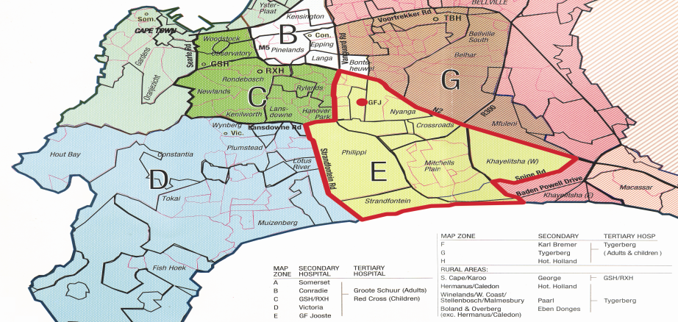
GF Jooste Hospital, Cape Flats
Area E = Drainage population of GF Jooste Hospital 1.5 million

Slide 4
Conclusions :
Gunshot injuries to the heart seldom survive to the hospital
Most of the death occur in emergency room or in theater (79%)
Right sided heart injuries occur more frequently then left sided injuries (50 vs. 36%)
Left ventricular injuries have a high mortality (43%)
Complex / multiple lacerations have highest mortality irrespective of heart chamber (62%)

Slide 5
…conclusions
Survivors are discharged home after average of 6 days
69 % of penetrating cardiac injuries survive in a regional trauma center in metropolitan South Africa

Slide 6
GFJ in-hospital survival varies from 48% to 93%

Slide 7
Penetrating cardiac injuries from GFJ drainage area to Mortuary (April 2006 – March 2008)

Slide 8
Penetrating Cardiac Injuries GFJ drainage area April 2006 – March 2008

Slide 9
Penetrating Cardiac Injuries GFJ drainage area April 2006 – March 2008

Slide 10
150 Penetrating Cardiac Injuries Autopsy reports

Slide 11
19 Epicardial injuries : 15 alive (78%)
8 Left atrium injuries : 7 alive (87%)
36 Left ventricle injuries: 18 alive (50%)
29 complex or multiple lacerations : 11 alive (38%)
15 Right Atrium injuries : 10 alive (66%)
47 Right ventricle injuries: 35 alive (74%)

Slide 12
205 PCI Autopsies : 58% Single / 42% multiple lacerations 40% GSW / 60% stab 13% Aortic laceration 17% Right Atrium 49% Right Ventricle 13% Inter Ventricular Septum
13% Pulmonary trunk
6% Left Atrium
40% Left Ventricle

Slide 13
Survival varies from 48% to 93%

Slide 14
Conclusion
In SA metro pole only 13% of PCI patients arrive alive at appropriate hospital
Survival rates depend on multiple factors
Over 80% survival can be achieved in a well performing system

